Slide 1

Machine Learning Presentation
Flowers Image Classifier
Name: Henok Daniel Kahsay
ID: 100053694

Slide 2



1. Introduction
- Classification of five types of flowers.
. Lilli, Lotus, Orchid, Sunflower, and Tulip
- Dataset obtained from Kaggle
- Includes 1000 images each

Slide 3
Objectives
Develop
Develop a CNN model that accurately classifies flowers
Evaluate
Evaluate the effectiveness of the model
Demonstrate
Demonstrate the potential of CNN models

Slide 4



Data Preprocessing
Batch size = 32
Image size = (224, 224)
80% for Training dataset
10% for Validation dataset
10% for Testing dataset

Slide 5
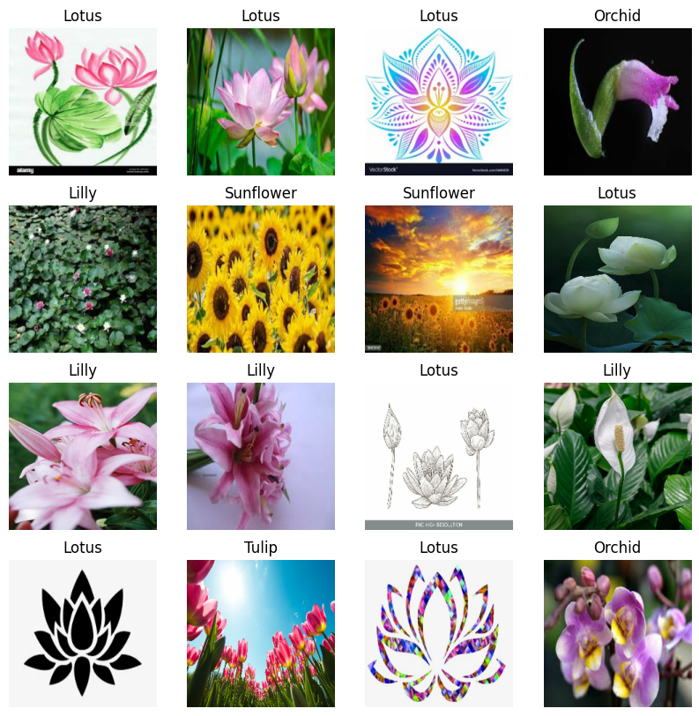

Slide 6
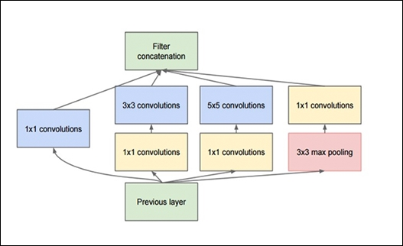
Model Development
Used InceptionV3 as Base model

Slide 7
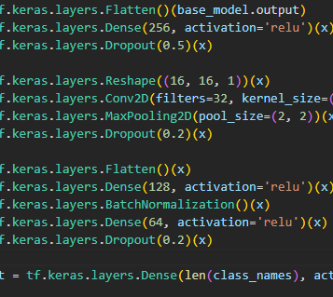
Model Development
Added the following layers to the base model

Slide 8
Model Evaluation
Trained for 30 epochs using Adam optimizer
Evaluated using the Testing dataset
The accuracy was 94.5%

Slide 9
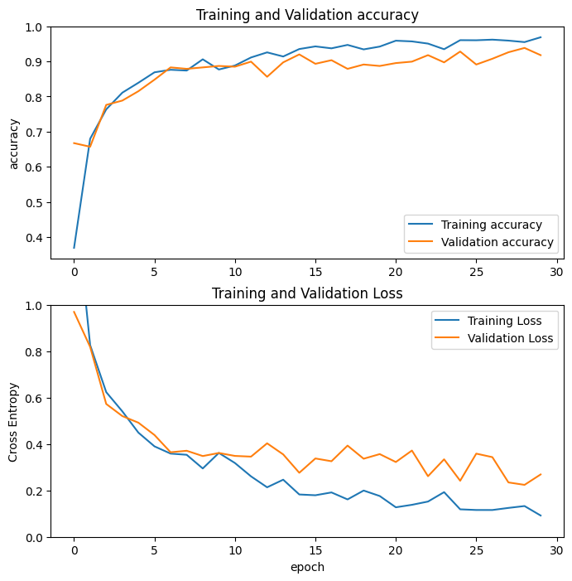

Slide 10

Thank you

